Slide 2
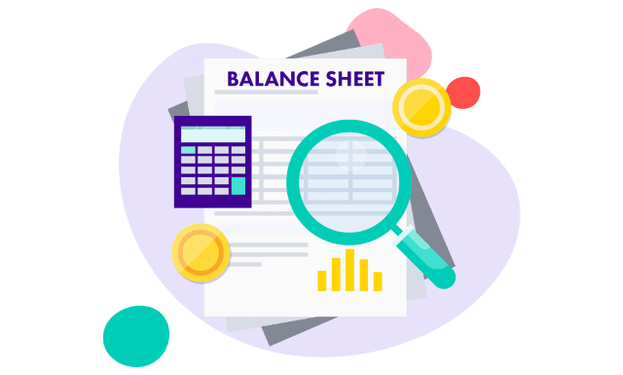
Lecture 8
Statement of Financial Position

Slide 3
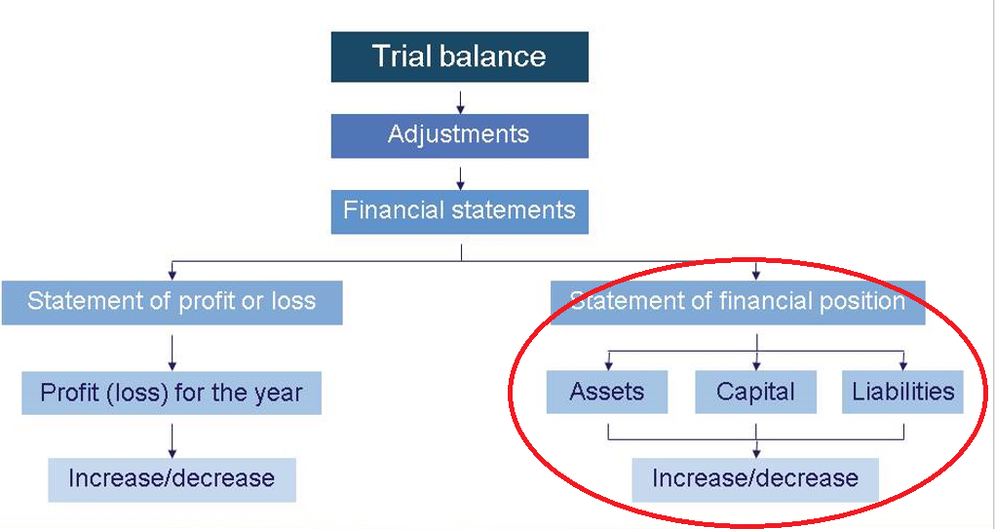

Slide 4
Learning Outcomes
After successful completion of session, students are able to….
Explain main purpose of Statement of Financial Position
Define assets, liabilities and owner’s equity
Explain how and why assets and liabilities are disclosed in the Balance Sheet
Draft a simple statement of financial position

Slide 5
What is Balance Sheet?
The statement of financial position is simply a list of all the assets owned and all the liabilities owed by a business as at a particular date.
It is a snapshot of the financial Standing of the business at a particular moment.
Assets = Liabilities + Owner’s Equity

Slide 6
Format of Balance Sheet
The essential features of all financial statements are:
Heading
 Name of the entity
 Title of the statement
 Date of the statement
Body of the statement

Slide 7
Balance Sheet-horizontal

Slide 8
Balance Sheet - vertical

Slide 9
Balance Sheet - formats
Working capital format
Fixed assets + (Current assets - Current liabilities) = Long-term liabilities + Capital
Net worth format
Fixed assets + (Current assets – Current liabilities) – Long-term liabilities = Capital.
Or
(Fixed Assets + Current Assets) – (Current Liabilities +Long-term Liabilities) = Capital

Slide 10
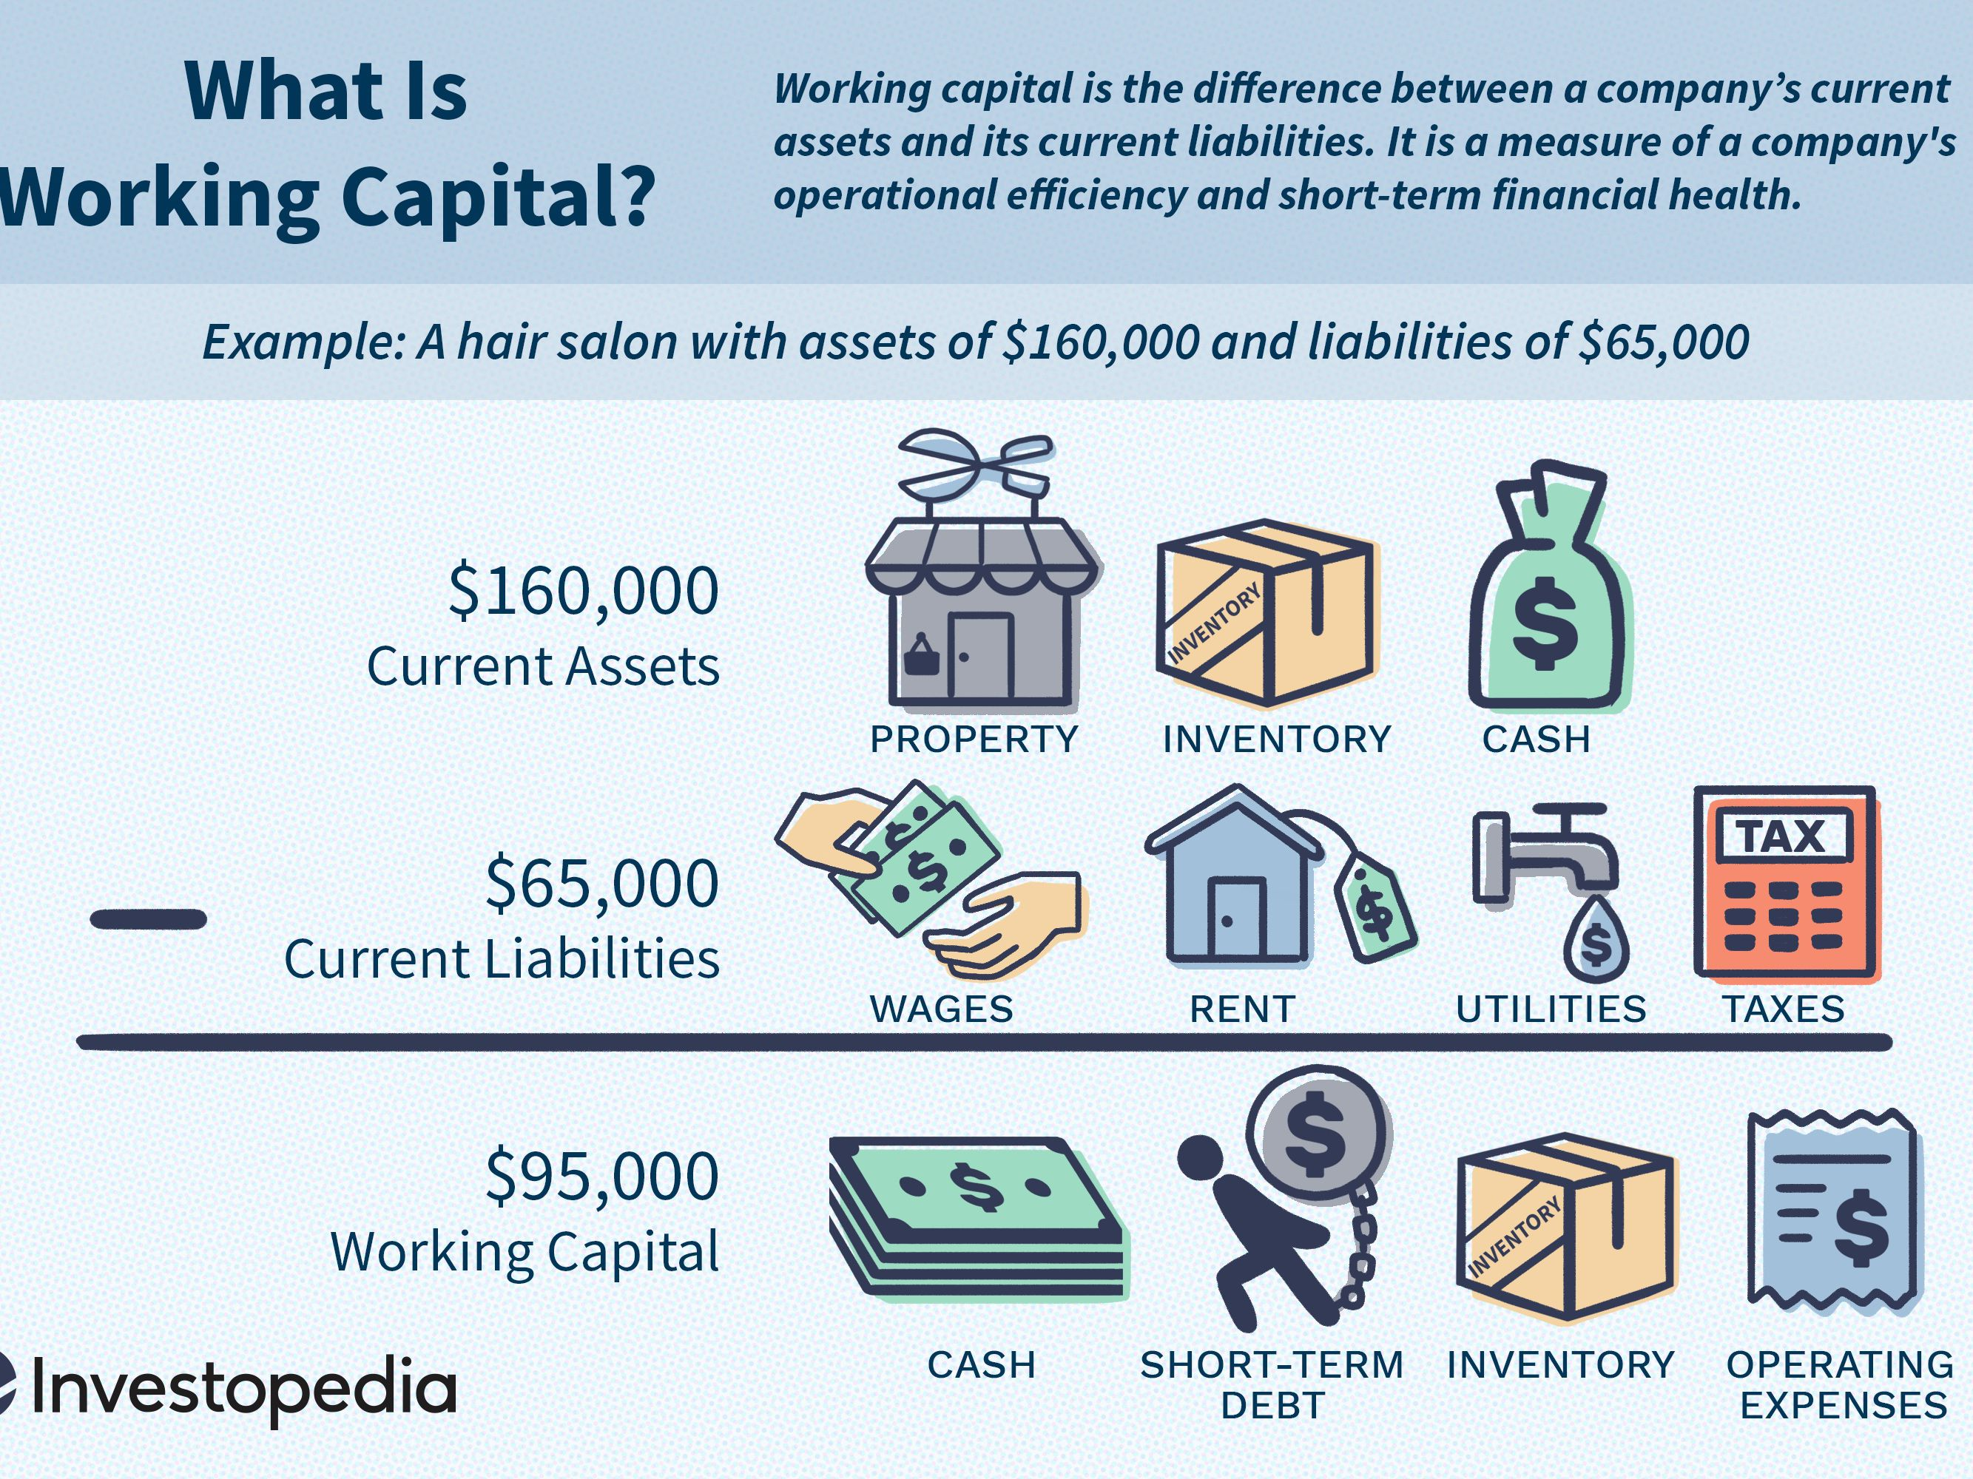

Slide 11
Assets
An asset is something valuable which a business owns or can use.
According to IASB’s conceptual framework, an asset is a resource controlled by an entity as a result of past events and from which future economic benefits are expected to flow to the entity.

Slide 12
Categories of Assets
ASSETS
FIXED ASSETS | TANGIBLE
 | INTANGIBLE
 | FINANCIAL
CURRENT ASSETS | CASH
 | STOCK
 | DEBTORS
 | PREPAYMENTS
 | INVESTMENTS

Slide 13
Tangible fixed assets
Tangible in Nature
FRS 15: Assets that have physical substance and are held for use in production or supply, for rental or for administrative purposes and expected to be used more than one period
Note: Fixed assets which will be kept longest listed 1st, down to those which will not be kept so long.
Actively Used in Operations
Expected to Benefit Future Periods
Called Property, Plant, & Equipment

Slide 14
Cost Determination
An asset must be carried on the balance sheet at the amount paid for it.
Purchase price
All expenditures needed to prepare the asset for its intended use
Acquisition Cost
The cost of an assets equals to:
- its purchase price (including import duties and any non-refundable tax);
- costs of “bringing the asset to the location and conditions necessary for it to be capable of operating in the manner intended by management”.
Acquisition cost excludes financing charges and cash discounts.

Slide 15
Cost determination: Land
Title insurance premiums
Purchase price
Delinquent
taxes
Real estate
commissions
Surveying fees
Title search and transfer fees
Land is not depreciable.

Slide 16
Cost determination: Truck
Purchase price
Taxes
Transportation
charges
Installing, assembling, and testing
Insurance while in transit

Slide 17
Acquisition cost of tangible FA
SPL Company on 15th September 2006 bought equipment for $100,000. Assembling cost was $ 5,000. When workers were bringing equipment to plant by accident they hit the wall and as a result SPL spent $3,000 to repair the wall and $2,000 to repair equipment. Before they started exploiting equipment they decided to test equipment and to produce some cloth. They bought raw materials for $1,000 and paid salaries for employees $2,000
What cost should be charged to SPL’s Balance Sheet as a cost of equipment?

Slide 18
Assets acquired in the middle of year
Charge a full year’s depreciation in the year of purchase and none in the year of disposal
Charge a full year’s depreciation in the year of disposal and none in the year of purchase
Charge depreciation at monthly rate throughout its life

Slide 19
Intangible Fixed Assets
Intangible assets are rights, privileges, and competitive advantages that do not possess physical substance.
Intangible assets are categorized as having either a limited life or an indefinite life.
Common types of intangibles:
Patents
Copyrights
Franchises or licenses
Trademarks or trade names
Goodwill

Slide 20


Intangible Fixed Assets
Patents grant to the organization the exclusive right to manufacture, sell, or control a product or process for a specific period of time.
Copyrights give the owner the right to reproduce and sell a published work or artistic creation.
Franchises, licenses are privileges granted by a private business or a government to sell goods or services under specified conditions.
Trademarks are rights that relate to brand or trade names. Word, phrase, jingle, or symbol that identifies a particular enterprise or product.

Slide 21
Accounting for Intangible Assets
Valuation
Purchased Intangibles:
Recorded at cost.
Includes all costs necessary to make the intangible asset ready for its intended use.
Internally Created Intangibles:
Generally expensed.
Only capitalize direct costs incurred in perfecting title to the intangible, such as legal costs.

Slide 22
Accounting for Intangible Assets
Amortization of Intangibles
Patent
Capitalize costs of purchasing a patent and amortize over its 20-year life or its useful life, whichever is shorter.
Expense any R&D costs in developing a patent.
Legal fees incurred successfully defending a patent are capitalized to Patent account.
Copyright
Copyright is granted for the life of the creator plus 70 years.
Capitalize acquisition costs.
Amortized to expense over useful life.
Trademarks**
Capitalize acquisition costs.
Cost of trademark or trade name is amortized over its useful life.
Franchises**, Licenses
Acquisition cost is amortized over its useful life.
** Intangibles with indefinite lives – no systematic amortization

Slide 23
Intangible Fixed Assets
Goodwill
Goodwill is recognized when one company acquires another company and pays more than the value of its net identifiable assets (assets less liabilities).
Goodwill can only result from the purchase of another company and represents the expected value of better-than-normal future operating performance
Goodwill is recorded as the excess of ...
purchase price over the FMV of the identifiable net assets acquired.
“It is defined as any excess of the price paid for a business over the fair market value of the identifiable asset and liabilities acquired at the date of the exchange transaction (IAS 38)”

Slide 24
Goodwill
Company A | Book Value | Fair value
Cash | $ 5,000 | $ 5,000
Accounts receivable | $ 75,000 | $67,000
Inventory | $ 35,000 | $ 32,000
PPE (net) | $ 201,515 | $ 235,000
Intangible assets | $ 20,000 | $ 20,000
Total Assets | $ 336, 515 | $ 359,000
Total liabilities | $ 150,000 | $ 150,000
Net Assets | $ 186,515 | $ 209,000

Slide 25
Goodwill
The fair value differs from book value in the example above because:
Fair value accounts receivable is lower than book value due to uncollectible accounts.
Fair value inventory is lower than book value due to obsolescence.
Fair value PPE is higher than book value due to depreciation being greater than the decline in PPE fair value.
If Company B purchases Company A for $250,000, the amount of economic goodwill “created” would be the purchase price minus the fair market value of net assets: $250,000 – $209,000 = $41,000.

Slide 26
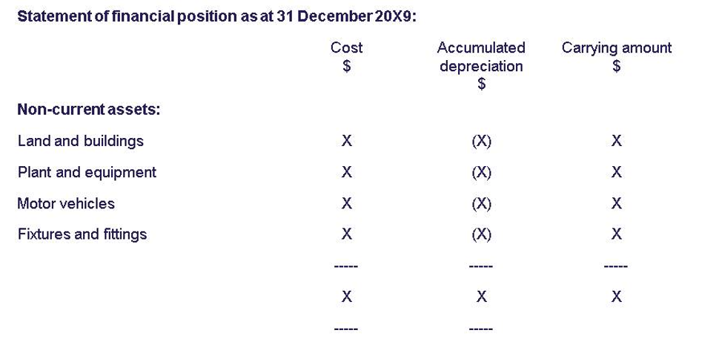
Non-Current Assets

Slide 27
Financial assets
Investment in subsidiaries (usually 100% ownership)
Investment in associated undertakings (partial ownership)
Other participating interests
Other investments

Slide 28
Current Asset
Expected to be realized in, or is held for sale or consumption in, the entity's normal operating cycle
Held primarily for the purpose of being traded
Expected to be realized within 12 months after the reporting date
Cash or a cash equivalent which is not restricted in its use

Slide 29
Current Assets
Current asset is an asset which will be used up within the current accounting period (normally taken as a period of one year) or which can be converted into cash.
Cash/Bank Account consists of “money in the hand” and Bank Accounts
Note: They are listed in increasing order of liquidity: Stock > Debtors > Cash at bank > Cash in hand
Listed investments (cash equivalents) are short-term, liquid investments in the shares of other companies listed on the stock exchanges

Slide 30
Current Assets
Petty Cash Account (cash equivalents) is the cash account available for everyday small expenses
Accounts Receivable (Trade Debtors) are amounts owed by customers for goods or services purchased accounts which arise from credit sales
A note receivable may arise from a sale or may be given in settlement of an account receivable. The maker pays the payee the maturity value. The maturity value includes principal plus interest
Prepayment is an amount paid in cash for a service that will be provided in a subsequent period.

Slide 31
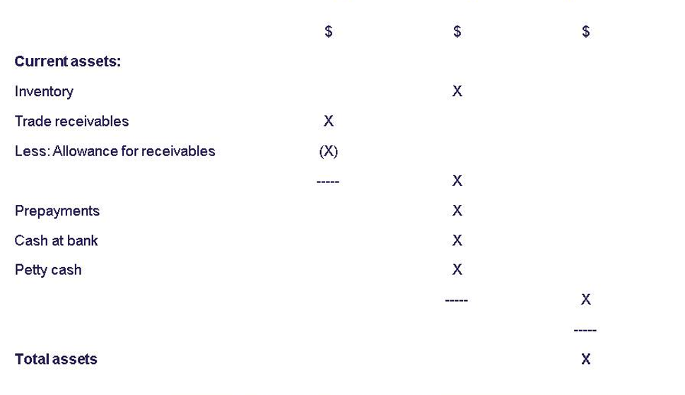

Slide 32
Liabilities
A liability is something which is owed to somebody else.
'Liabilities' is the accounting term for the debts of a business.
According to IASB’s conceptual Framework, a liability is a present obligation of the entity arising from past events, the settlement of which is expected to result in an outflow from the entity of resources embodying economic benefits.

Slide 33
Categories of liabilities
LIABILITIES
SHORT-TERM (CURRENT) | BANK OVERDRAFT
 | ACCOUNTS PAYABLE
 | ACCRUED TAX
 | PAYROLL
 | CURRENT PORTION OF LONG-TERM DEBT
LONG -TERM | BOND
 | MORTGAGE
 | DEBENTURE

Slide 34
Current Liabilities
A liability should be classified as a current liability when it is:
Expected to be settled in the entity's normal operating cycle
Due to be settled within 12 months of the reporting date
Held primarily for the purpose of being traded

Slide 35
Current Liabilities
Short-term notes payable are notes payable due within one year. In addition to recording the note payable the business must also pay interest expense
Current portion of long-term debt - it is the amount of the principal that is payable within one year. At the end of the year, a company reclassifies the amount of its long-term debt that must be paid during the upcoming year.
Accrued expenses these are expenses that have been incurred but not recorded (taxes payable, unpaid salaries, interest, dividends)
Bank overdrafts – is a facility granted by a bank that allows a customer holding a current account with the bank to spend more than the funds in the account.
Interest is charged daily on the amount of the overdraft on the date and the overdraft is repayable at any time upon request from bank

Slide 36
Long-term Liabilities
Debentures– loans to a company which carry a fixed rate of interest based on the nominal value.
Example: 10% debentures with a nominal value of $1,000 each carry an annual interest of $100 per debenture certificate.
Bonds (secured debentures) – these are debentures which are “secured” against specific fixed assets owned by the company.
In the event the company cannot pay back the principal liability, the bondholders possess the “rights of ownership” to the fixed assets which can then be disposed off to settle the amount owing to the lenders.

Slide 37
Long-term Liabilities
Unlike dividends, interest on debentures and bonds must be paid.
Another difference is interest on debentures and bonds is an expense charged against profit and appear in P&L account, whereas dividends constitute an appropriation of profit.
Redeemable debentures / bonds – debentures or bonds which are repayable at or by a certain date.
Irredeemable debentures / bonds – debentures or bonds which are normally repayable only when the company is terminated or liquidated (similar to perpetuity).

Slide 38
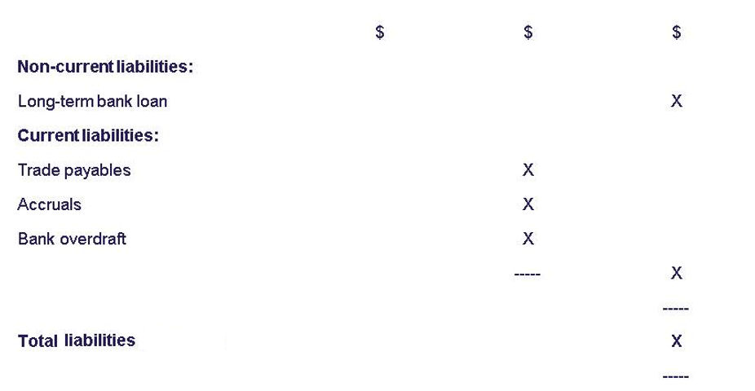
Long-term Liabilities

Slide 39
Owner’s equity
Owner’s equity is amount introduced by owner into business.
Made up three elements - funds introduced by owner, e.g. cash - profits earned/loss made by business entity - drawings, i.e. funds taken out of the business by the owner

Slide 40
Owner’s equity
Issued Share Capital
(at par value)
Reserves
General Reserve
Preferred
Share
Capital
Ordinary
Share
Capital
Specific
Reserves
Share Premium
Account
Retained Profits

Slide 41
Owner’s equity
Paid-in capital comes from the corporation’s stockholders who already invested in the company.
Retained earnings come from the corporation’s customers. It shows the amount of income allowed to accumulate from the beginning of the corporation’s life to the present, it is undistributed profits. It represents a claim on assets, but it is not cash.

Slide 42
Ordinary Shares
High Risk, High Potential Return
Dividends are not fixed in advance (might not even be paid)
Last claim on company’s assets (e.g. in case of liquidation)
Full voting rights – it gives control over the operations of the company to the shareholders through the right to appoint the directors
In the balance sheet, shares must be recorded at par or nominal values.
Companies often issue shares at prices exceeding the par values. Any payment in excess of par value made by shareholders will be recorded under a different account called the share premium account.

Slide 43
Lower Risk, Lower Potential Return
Preferred Shares
Fixed dividend (usually in percentage of nominal value)
First claim on assets
Limited or no voting rights
Can be of the following types:
Callable (redeemable) may be paid off and cancelled under terms in the original offer document.
Cumulative - any dividend “entitlement” not declared in any particular year carries forward to the following year/s and would need to be settled in the later year together with that year’s preference entitlement before the ordinary shares could expect any dividend at all.

Slide 44
Aspect | Ordinary shares | Preference shares
Voting power | Carry a vote. | Do not usually carry a vote
Distribution of profits (dividends) | A dividend which may vary from one year to the next after the preference shareholders have received their dividend | A fixed dividend before any dividends paid on ordinary shares.
Liquidation of company | Entitled to surplus assets on liquidation after all liabilities and preference shares have been repaid. | Priority of repayment over ordinary shares, but not usually entitled to surplus assets on liquidation

Slide 45
Dividends
Dividend – is a payment of part of the profits made by the company to the shareholders.
Dividends are commonly expressed as a percentage of the par or nominal values of the shares.
For example:
a) 8 % preference shares with a par value of $1 per share carry an annual dividend of 8 cents per share if paid.
Companies need to keep a list of who owns their shares, so that they can pay dividends due to shareholders.

Slide 46
Dividends
Companies pay dividends twice a year – an interim and a proposed final dividend.
Interim dividends are paid based on the results of the first 6 months of the financial year and would already have been paid by the balance sheet date (thus it will appear in the trial balance).
The final dividend is proposed based on the results of the full financial year, thus it would normally still be outstanding at the balance sheet date and will appear as a current liability in the balance sheet.

Slide 47
Share Capital: different meanings
Authorized share capital – the maximum number of shares which the company is allowed to issue to shareholders.
Issued (allotted) share capital – the total nominal number of shares that have actually been issued at the date of the balance sheet.
Issued share capital will equal to authorized share capital if all of the authorized share capital has been issued.

Slide 48
Share Capital: different meanings
Called-up capital – where only part of the amount payable on each issued share has been asked for.
Paid-up capital – the amount of share capital which has been paid for by shareholders.
Uncalled capital – is the total amount which is to be received in future relating to issued share capital, but which has not yet been asked for.
Calls in arrears – total amount for which payment has been asked for but has not yet been paid by shareholders

Slide 49
Example
Better Enterprises Ltd was formed with the legal right to be able to issue 1,000,000 shares of $1each.
The company has actually issued 750,000 shares.
None of the shares has yet been fully paid up. So far the company has made calls of 80p per share.
All the calls have been paid by shareholders except for $200 owing from shareholder.
How would you reflect these points ?

Slide 50
Solution to Example
Authorized share capital = $1 000 000
Issued share capital =$750,000
Called-up share capital =750,000*$0.8=$600,000
Uncalled share capital = 750,000*$0.2=$150,000
Calls in arrears amounted to = $200
Paid-up share capital = $600,000 - $200=$599,800

Slide 51
TRIAL BALANCE OF GERRY LTD AS AT 31.3.X6
 | Dr. | Cr.
Ordinary shares $1 |  | 100,000
6% preference shares $1 |  | 20,000
8% debentures |  | 30,000
Share premium |  | 9,500
Revaluation reserve |  | 10,000
General reserve |  | 12,000
Accumulated profit b/f 1.4.X5 |  | 976
Non-current assets (cost $210,000) | 191,000
Stock 1.4.X5 | 14,167
Debtors and creditors | 11,000 | 7,500
Provision for doubtful debts |  | 324
Bank | 9,731
Purchases and sales | 186,000 | 271,700
Wages and salaries | 31,862
General expenses | 15,840
Debenture interest | 1,200
Preference dividend | 1,200
 | 462,000 | 462,000
Additional info:
1. Inventory 31.3.X6
- $23,483
Depreciation of non-current assets – 10% per annum at cost
Prov. for doubtful debt – 5% of debtors
$1,200 debenture interest & $1,437 general expenses to be accrued
$925 of general expenses have been paid in advance
Provision for taxation -$9,700
Directors decided to increase the general reserve by a further $3,000

Slide 52
Lecture Roundup
It is crucial to prepare Balance Sheet for a sole trader and for a company from a trial balance after incorporating period-end adjustments for depreciation, inventory, prepayments, accruals, bad and doubtful debts, provision for doubtful debts
There are some important differences between the accounts of a limited liability company and those of sole traders or partnerships
In preparing a Balance Sheet you must be able to deal with:
– Assets, liabilities
– Ordinary and preference share capital
– Reserves
Share capital and reserves are 'owned' by the shareholders. They are known collectively as 'shareholders‘ equity‘
A company can increase its share capital by means of a bonus issue or a rights issue.

Slide 53
References:
ACCA (2017) Approved Interactive Text. Foundations in Accountancy FFA 2017/2018. BPP Media Ltd, Chapter 18, 19 & 20
Perks, R (2004) Financial Accounting for Non-specialists, chapters: 1,2, 10,11
Dyson, J.R (2004) Accounting for Non-Accounting Students, chapter 4,6
Wood F & Sangster A, Business Accounting 1, chapters 7,8, 9, 45
Glautier, M & Underdown B (2001) Accounting Theory and Practice, 7th edition, chapter 11,14.
Weetman, P. (1996) Financial Accounting, an Introduction, Pitman Publishing, chapters 8, 9, 10, 11.
ACCA (2006) Approved text for the professional qualification, Study Text 2006/07, Paper 1. INT,Kaplan publishing: Foulks Lynch, chapter 7, 15, 16, 19,20.
Britton, A. & Waterson, C. (2003) Financial Accounting, Pearson Education Limited, third edition, chapters 2, 7.
Pendlebury, M. & Groves, R. (2001) Company Accounts: Analysis, Interpretation and understanding, 5th edition, Thomson publishing, chapter 2.

